Slide 1

Intro to Python Objects – Part 1

Slide 2
Python Objects
Variables are simply names that are used to keep track of information.
Variables are created when they are first assigned a value.
Variables must be assigned before they can be used.
Variables will take the form of Python objects. We will use 3 different objects:
Numbers: integers, real number, etc …
Strings: ordered sequences of characters
Lists: ordered collection of objects
Python objects are dynamically typed, meaning you don’t have to declare the type of the variable upon creation.

Slide 3
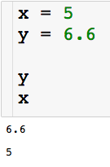
Creating Variables
Let’s create our first variables
Code cell
The code executes from top to bottom

Slide 4
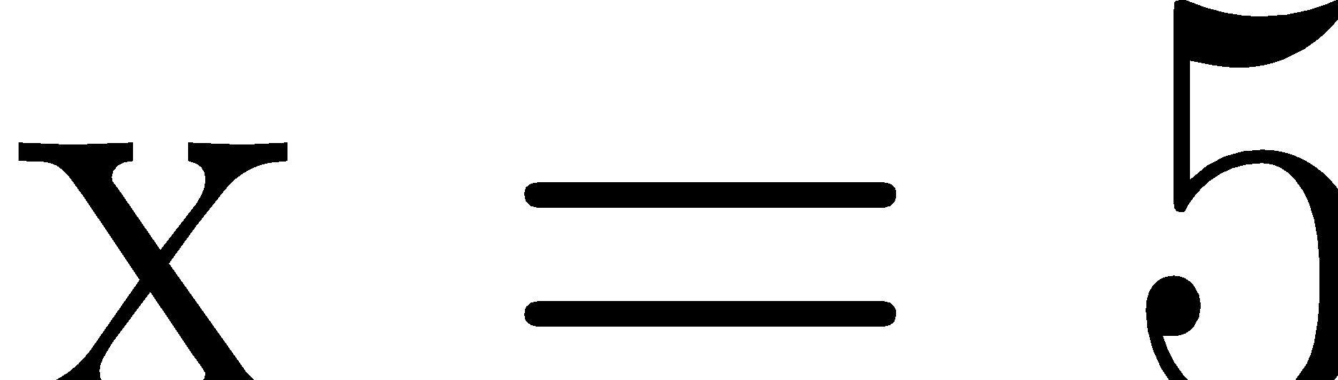
Creating Variables
Let’s create our first variables

Slide 5
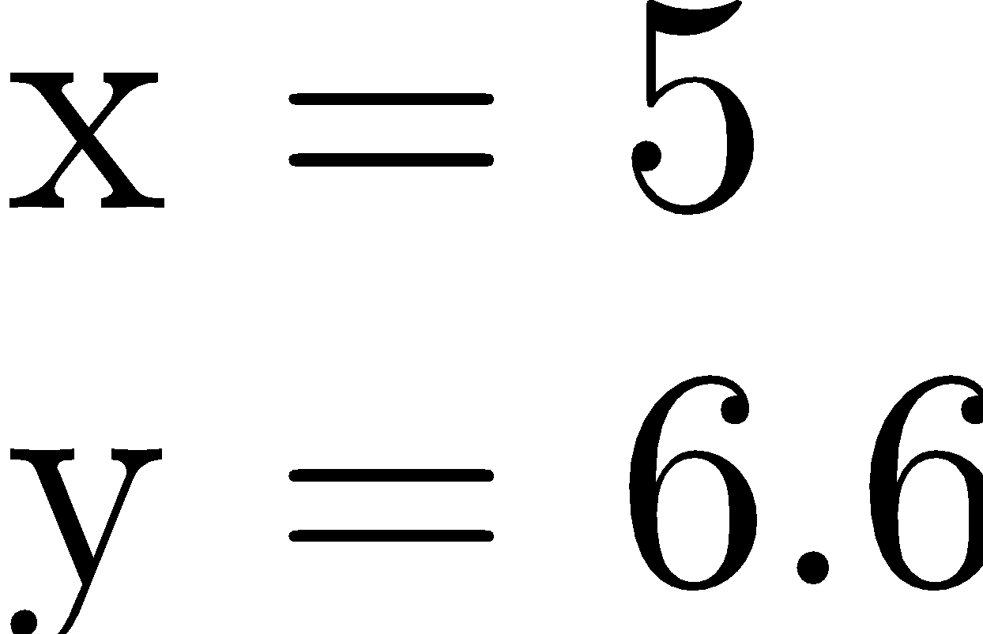
Creating Variables
Let’s create our first variables. These variables with be numbers.

Slide 6
Creating Variables
Let’s create our first variables

Slide 7
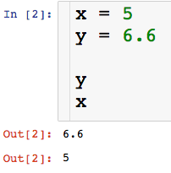
Creating Variables
Let’s create our first variables
Code cell
A couple of things about Jupyter

Slide 8
Creating Variables
Let’s create our first variables
Code cell
Order in which cells have been run
A couple of things about Jupyter

Slide 9
Creating Variables
Let’s create our first variables
Code cell
Order in which cells have been run
Output, we get this by typing variable names
A couple of things about Jupyter

Slide 10
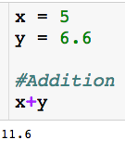
Arithmetic Operations
# = comment

Slide 11
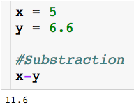
Arithmetic Operations

Slide 12
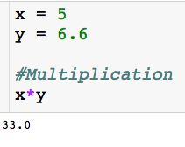
Arithmetic Operations

Slide 13
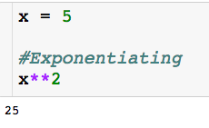
Arithmetic Operations

Slide 14
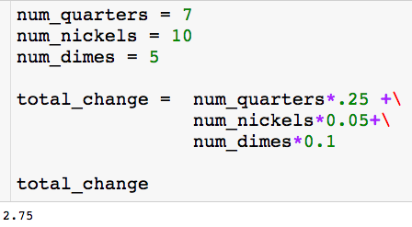
Using Variables
Use description variable name
Rule for creating variable names:
Be descriptive and separate words with underscore
No spaces
No punctuation other than underscore

Slide 15
Using Variables
Use description variable name
The backslash lets you continue your block of code on the next line.

Slide 16
Using Variables
Use description variable name
I can create variables that are a function of other variables
The backslash lets you continue your block of code on the next line.

Slide 17
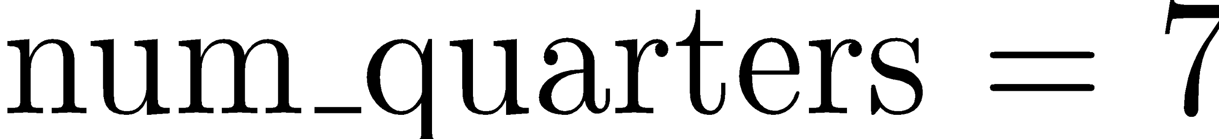
Using Variables

Slide 18
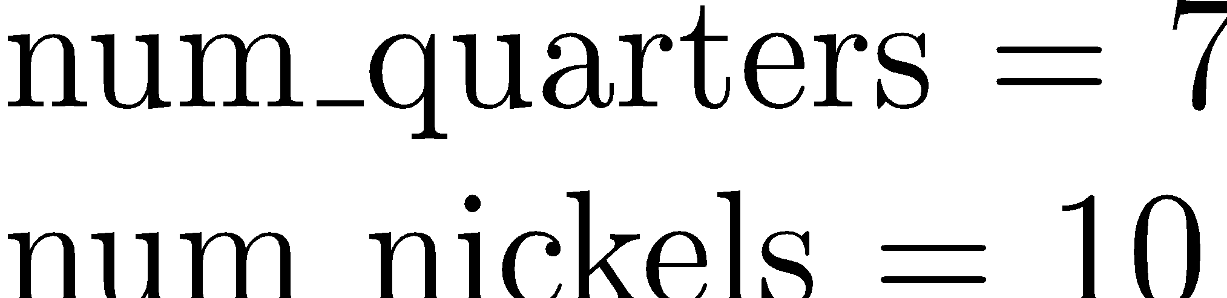
Using Variables

Slide 19
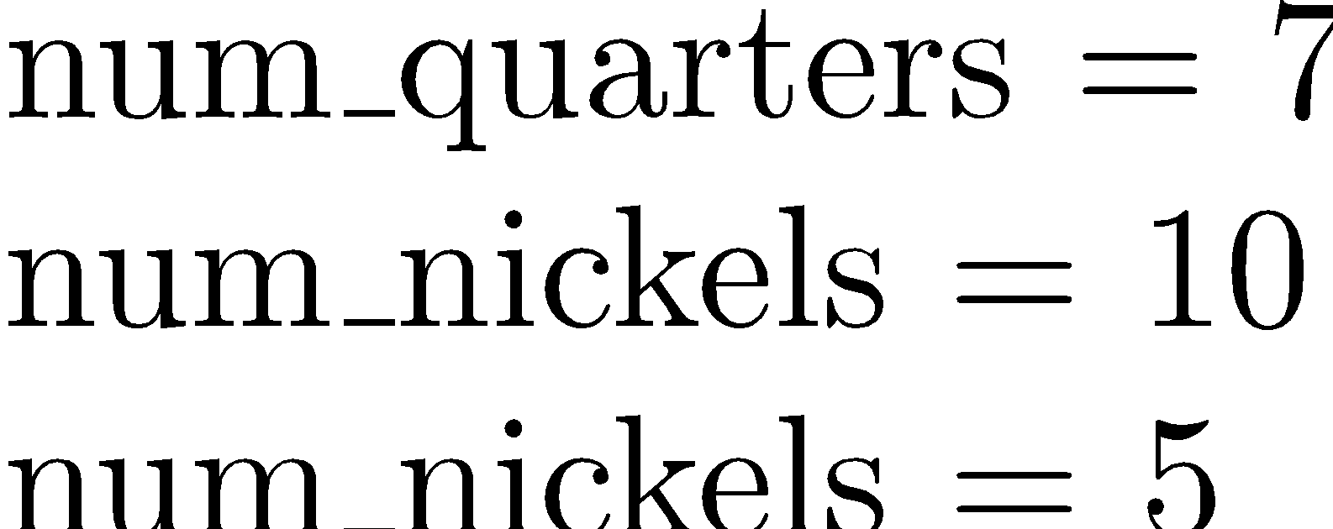
Using Variables

Slide 20
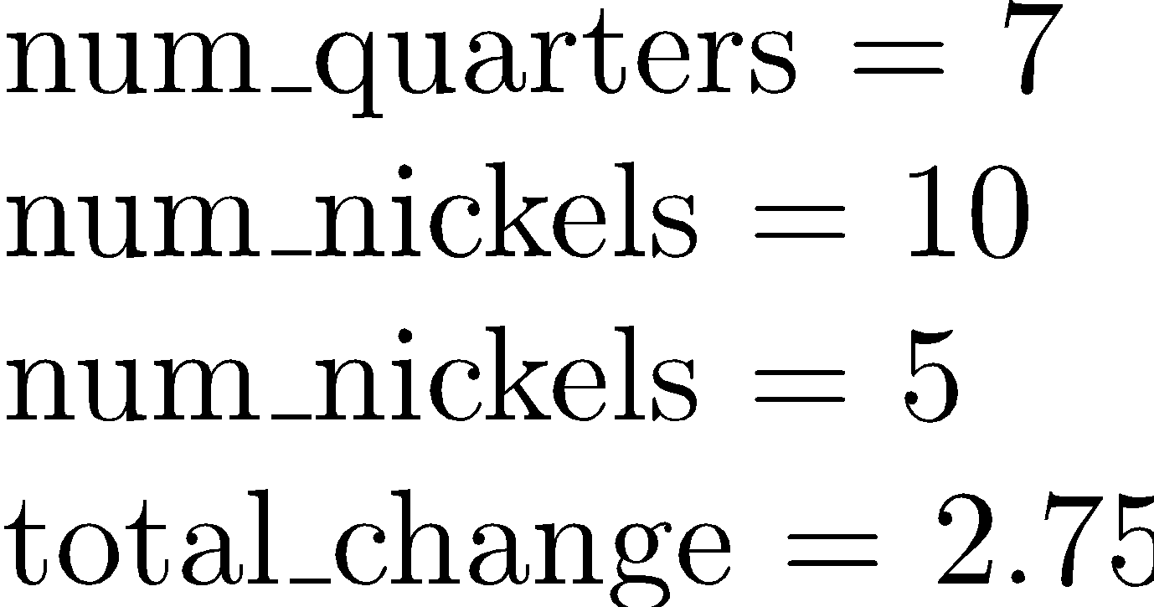
Using Variables

Slide 21
Using Variables
This just prints the value stored in the variable so we can see it.

Slide 22

Using Variables
You will often find yourself updating variables:
Some other code executes…want to add 1 to count

Slide 23
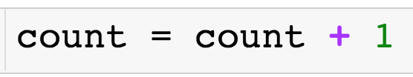
Using Variables
You will often find yourself updating variables:
Some other code executes…want to add 1 to count

Slide 24
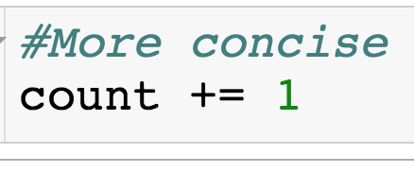
Using Variables
You will often find yourself updating variables:
Some other code executes…want to add 1 to count

Slide 25
Booleans
The Boolean type can be viewed as numeric in nature because its values (True and False) are just customized versions of the integers 1 and 0.
The True and False behave in the same way as 1 and 0, they just make the code more readable.
Let us check if specified conditions are true

Slide 26
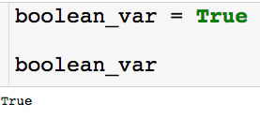

Booleans
Creating boolean variable:
Note that the boolean does behave exactly like a 1:

Slide 27



Conditional Tests
Sets the variables x equal to 5.
Asks if x is equal to 5. Returns boolean.
Asks if x is less than or equal to 4. Returns boolean.

Slide 28
Strings
Python strings are an ordered collection of characters (usually these characters will be letters and numbers) used to represent text.
String are created by placing single or double quotation marks around a sequence of characters.
Strings support the following operations
concatenation (combining strings)
slicing (extracting sections)
Indexing (fetching by offset)
the list goes on ….

Slide 29
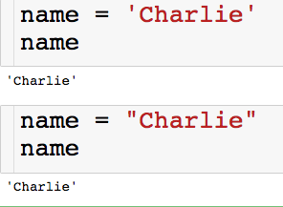
Strings
Let’s create our first strings
You can create a string with either single or double quotes.
There is a left to right ordering that we will explore on the next slide

Slide 30








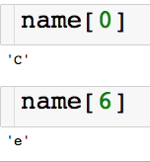
Indexing Strings
We can access the characters of the string through their index
Slicing single characters through e index:
(pretend there aren’t spaces between the letters)

Slide 31

Slicing Strings
We can access the characters of the string through their index
Slicing contiguous characters:
(pretend there aren’t spaces between the letters)
start
finish (non-inclusive)

Slide 32
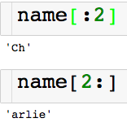
Slicing Strings
We can access the characters of the string through their index
Slicing contiguous characters:
(pretend there aren’t spaces between the letters)
If start index is left blank defaults to 0
If end index is left blank defaults to end of the string

Slide 33
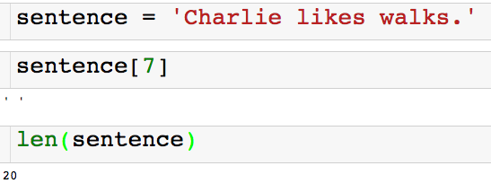
Slicing Strings
We can access the characters of the string through their index
Spaces and punctuation count in the indexing of a string!

Slide 34
Slicing Strings
We can access the characters of the string through their index
Returns the number of characters in the string

Slide 35
String Concatenation
I can combine strings using the + operator.
So the + operator between two numbers add them and the + operator between two strings concatenates them! This is called polymorphism.

Slide 36
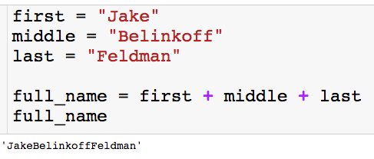
String Concatenation
I can combine strings using the + operator.
So the + operator between two numbers add them and the + operator between two strings concatenates them! This is called polymorphism.
If we want a space, we have to say so.

Slide 37
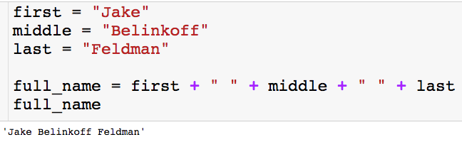
String Concatenation
I can combine strings using the + operator.
So the + operator between two numbers add them and the + operator between two strings concatenates them! This is called polymorphism.
With the space

Slide 38
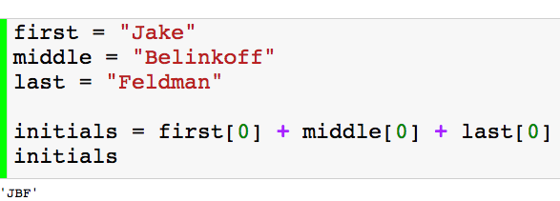
String Concatenation
I can combine strings using the + operator.
So the + operator between two numbers add them and the + operator between two strings concatenates them! This is called polymorphism.
Another example

Slide 39
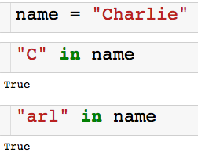

Using In
We can use the keyword in to check if a string is contained in another string.
There is also a not in:

Slide 40
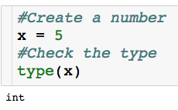
Checking the Type
For any variable, we can check what kind of object it is:
Built in type function

Slide 41
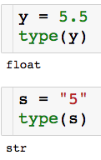
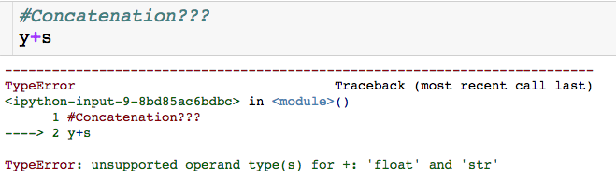
Why the Type Matters
We can’t concatenate a string and a number…and we shouldn’t be able

Slide 42
Why the Type Matters
type() can be helpful for debugging
Another reason to have descriptive variable names

Slide 43
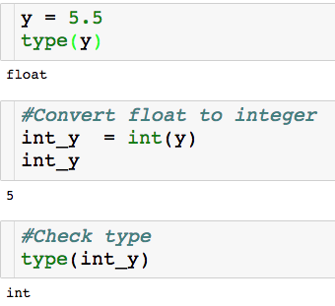
Converting Types
Built in int() function
int() is one way to perform a floor operation

Slide 44
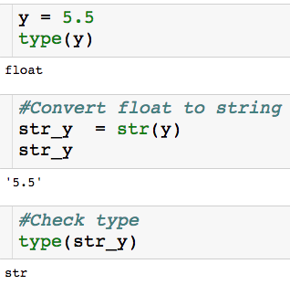
Converting Types
Built in str() function

Slide 45
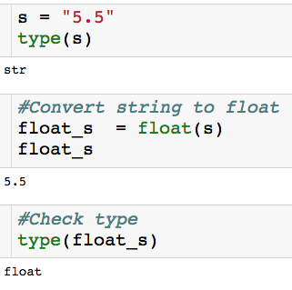
Converting Types
Built in float() function

Slide 46
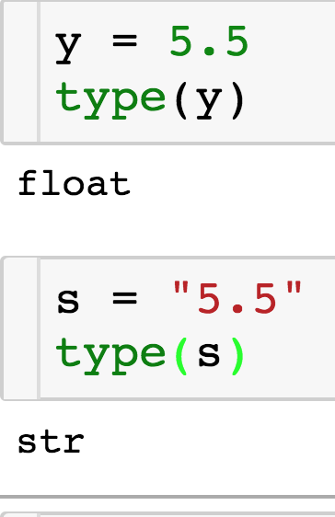
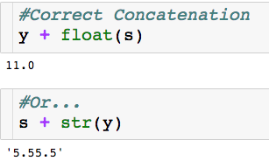
Why the Type Matters

Slide 47
Digging Deeper into Python Objects
Every Python Object is either mutable or immutable
Mutable: Can be changed once created - a list L can have its first element replaced.
Immutable: Can’t be changed once creating – a string S cannot have its first letter changed.

Slide 48
Digging Deeper into Python Objects
Every Python Object is either mutable or immutable
Mutable: Can be changed once created - a list L can have its first element replaced.
Immutable: Can’t be changed once creating – a string S cannot have its first letter changed.
What we know so far:
Numbers = Immutable
String = Immutable
Lists = Mutable

Slide 49
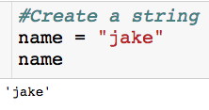
Example of Immutability
Let’s say I want to change the first letter of name to a “J”

Slide 50
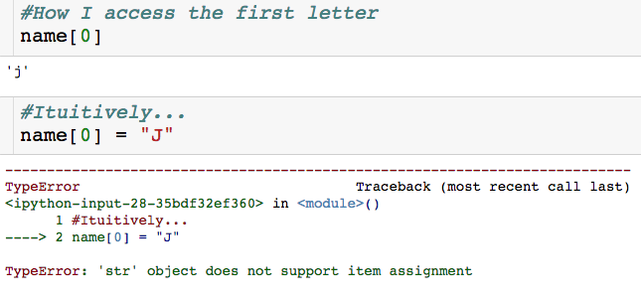
Example of Immutability
Let’s say I want to change the first letter of name to a “J”
Can’t change name once it is created!

Slide 51
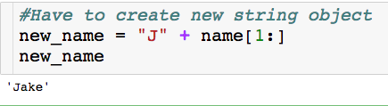
Example of Immutability
Let’s say I want to change the first letter of name to a “J”

Slide 52
Example of Immutability
Let’s say I want to change the first letter of name to a “J”
We will see an easier way to do this…

Slide 53
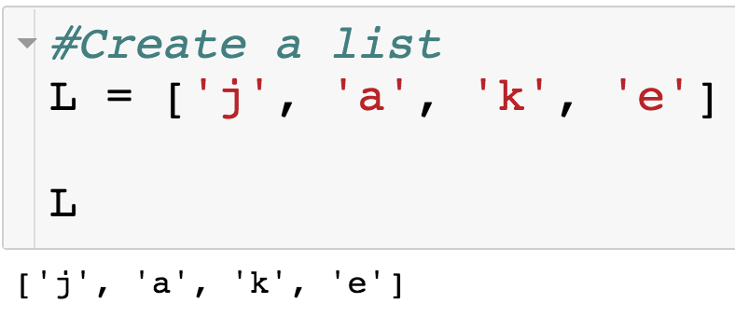
Example of Mutability
Let’s say I want to change the string in index 0 to a “J”.

Slide 54
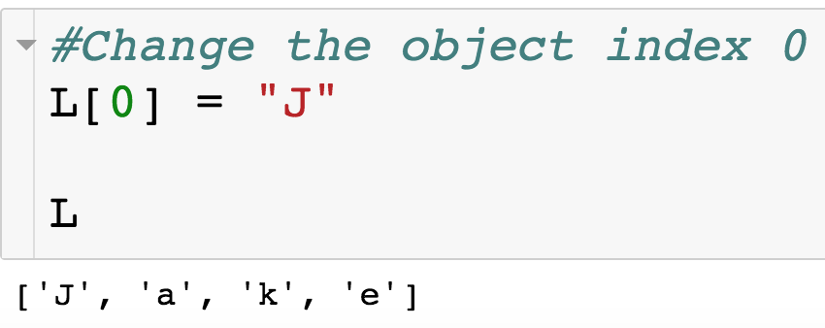
Example of Mutability
Let’s say I want to change the string in index 0 to a “J”.
Since lists are mutable, we change an any part of list after it has been created.

Slide 55

Conditionals and Loops

Slide 56
If Statement
Execute a certain block of code only if a certain condition is true

Slide 57
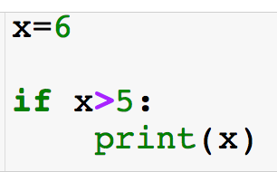
If Statement
Execute a certain block of code only if a certain condition is true
Conditional: must return boolean
If statements always begin with an “if”

Slide 58
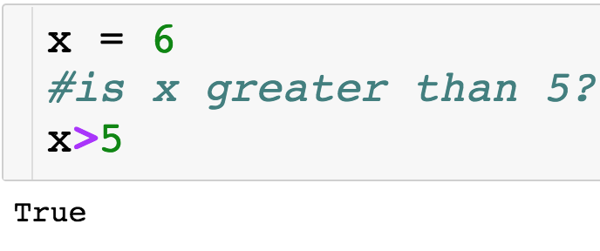
If Statement
Execute a certain block of code only if a certain condition is true
Conditional: must return boolean
If statements always begin with an “if”

Slide 59
If Statement
Execute a certain block of code only if a certain condition is true
Conditional: must return boolean
“:” ends statement
If statements always begin with an “if”

Slide 60
If Statement
Execute a certain block of code only if a certain condition is true
Conditional: must return boolean
“:” ends statement
If statements always begin with an “if”
If condition is true, then indented line of code will run

Slide 61
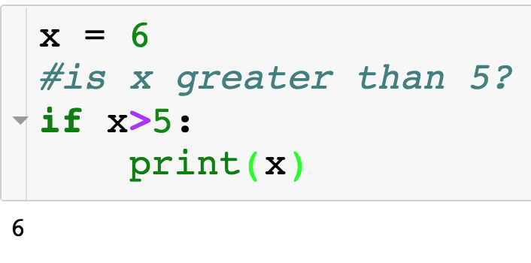
If Statement

Slide 62
If + Else Statement
Else statement allows us to specify separate directions if the condition with the if is False.

Slide 63
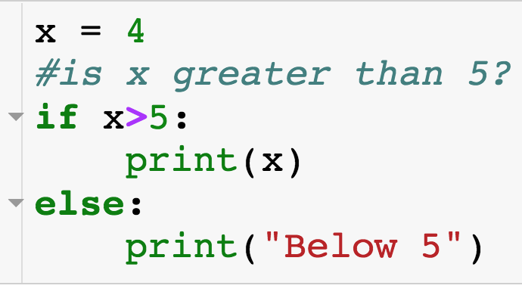
If + Else Statement
Else statement allows us to specify separate directions if the condition with the if is False.
Else always executes when the if condition is False.
Match if + else by indentation
Else is optional, meaning an if statement doesn’t have to have an accompanying else.

Slide 64
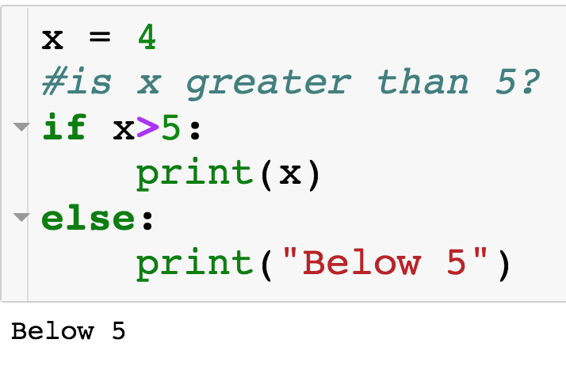
If + Else Statement
If condition is False, so code inside of else executes

Slide 65
If + Elif + Else Statement
How do I specify multiple conditions?...

Slide 66
If + Elif + Else Statement
How do I specify multiple conditions?...elif

Slide 67
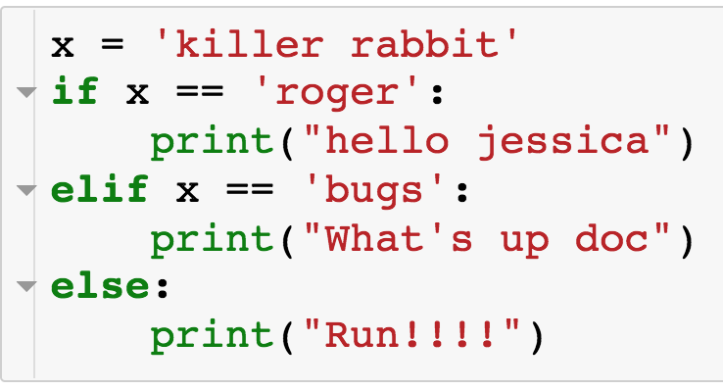
If + Elif + Else Statement
How do I specify multiple conditions?...elif
Comes between if and else
Can have arbitrary number of elifs
First if/elif condition that is true is executed and only this block is executed
If no if/elif condition is true then else is executed
Indentation matches up if/elif/else statements

Slide 68
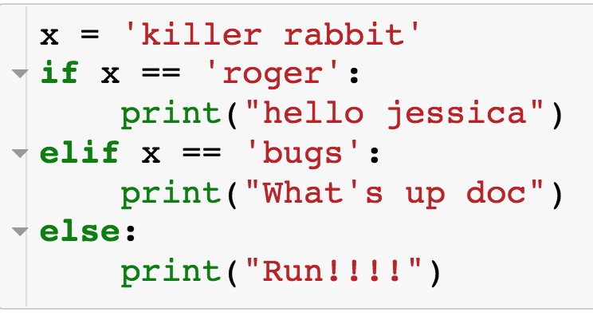
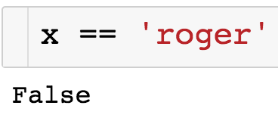
If + Elif + Else Statement

Slide 69
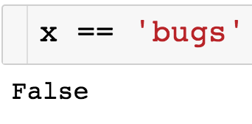
If + Elif + Else Statement

Slide 70
If + Elif + Else Statement
Since all if/elif conditions were False, else statement executes

Slide 71
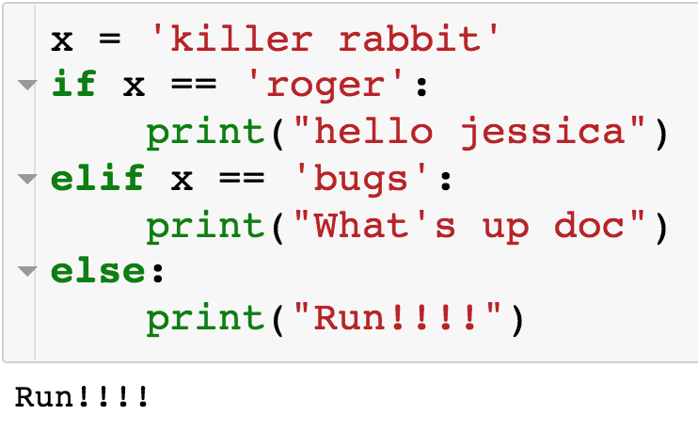
If + Elif + Else Statement

Slide 72
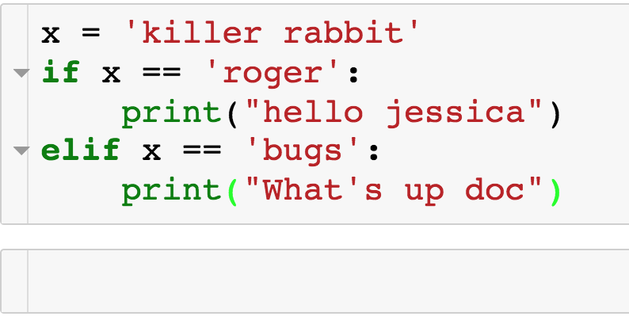
If + Elif + Else Statement
We can just have an if + elif, with no else:

Slide 73
If + Elif + Else Statement
We can just have an if + elif, with no else:
Nothing is printed since neither if not elif condition is true

Slide 74
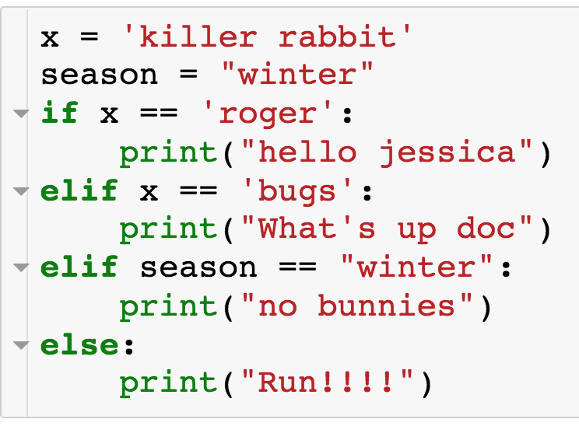
If + Elif + Else Statement
Example with multiple elif conditions:

Slide 75
If + Elif + Else Statement
Example with multiple elif conditions:

Slide 76
If + Elif + Else Statement
Example with multiple elif conditions:

Slide 77
If + Elif + Else Statement
Example with multiple elif conditions:

Slide 78

If + Elif + Else Statement
Example with multiple elif conditions:

Slide 79
If + Elif + Else Statement
Example with multiple elif conditions:

Slide 80
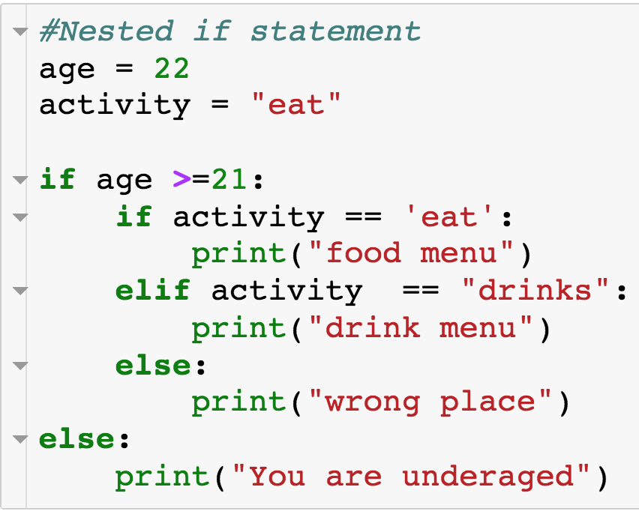
Nested Conditionals
We can have if statements nested within if statements:

Slide 81
Nested Conditionals
We can have if statements nested within if statements:

Slide 82
Nested Conditionals
We can have if statements nested within if statements:

Slide 83
Nested Conditionals
We can have if statements nested within if statements:

Slide 84

Nested Conditionals
We can have if statements nested within if statements:

Slide 85

Nested Conditionals

Slide 86

Nested Conditionals

Slide 87
Specifying Multiple Conditions
How do you specify multiple conditions in a conditional statements?

Slide 88

Specifying Multiple Conditions - and
How do you specify multiple conditions in a conditional statements?
Condition 1
Condition 2
Conditional statements w/ “and”

Slide 89
Specifying Multiple Conditions - and
How do you specify multiple conditions in a conditional statements?
Condition 1
Condition 2
AND
All conditions must evaluate to True
Can have arbitrary number of conditions

Slide 90

Specifying Multiple Conditions - and
How do you specify multiple conditions in a conditional statements?

Slide 91

Specifying Multiple Conditions - or
How do you specify multiple conditions in a conditional statements?
Condition 1
Condition 2
Conditional statements w/ “or”

Slide 92
Specifying Multiple Conditions - or
How do you specify multiple conditions in a conditional statements?
Condition 1
Condition 2
OR
At least one condition must evaluate to True
Can have arbitrary number of conditions

Slide 93

Specifying Multiple Conditions
How do you specify multiple conditions in a conditional statements?

Slide 94
For Loops
Use cases of for loops:
Iterate over the elements of a list or string
For each element, perform some sort of operation - count or sum
Perform some action a specified number of times
Deal out 5 cards
Have a student go through all 100 lockers

Slide 95

For Loops w/ List
Compute sum of elements of a list
Use for loop to iterate over the elements of the list

Slide 96
For Loops w/ List
Compute sum of elements of a list
Use for loop to iterate over the elements of the list
Keyword “for”
Loop variable – takes on each value of loop target
Loop target – object to be iterated over

Slide 97

For Loops w/ List
Can call loop variable whatever you want
Block of code to run each iteration of for loop

Slide 98

For Loops w/ List

Slide 99

For Loops w/ List

Slide 100

For Loops w/ List

Slide 101

For Loops w/ List

Slide 102

For Loops w/ List

Slide 103

For Loops w/ List

Slide 104

For Loops w/ List

Slide 105

For Loops w/ Strings
Now the loop target is a string
Compute the number of words in sentence

Slide 106

For Loops w/ Strings

Slide 107
For Loops w/ Strings

Slide 108

For Loops w/ Strings

Slide 109
For Loops w/ Strings

Slide 110

For Loops w/ Strings
…

Slide 111
For Loops w/ Strings

Slide 112

For Loops w/ Strings

Slide 113
For Loops w/ Strings

Slide 114

For Loops w/ Strings

Slide 115


For Loops w/ Strings

Slide 116
Summary: For Loops w/ Strings or Lists
The loop target can be a string or a list
If the loop target is a list – iterate over the elements of the list by increasing index
If the loop target is a string – iterate over the characters of the string by increasing index
We will see other python objects that can be loop for targets

Slide 117

Range
start (defaults to 0 if left off)
end (non-inclusive)
Built-in range function

Slide 118
Range
start (defaults to 0 if left off)
end (non-inclusive)
Built-in range function
Can use range(0,n) as loop target
Need consecutive integers
Need to repeat something n times

Slide 119

For Loops w/ Range
Using range() as loop target to get consecutive integers
Compute even numbers >=0

Slide 120

For Loops w/ Range

Slide 121
For Loops w/ Range

Slide 122

For Loops w/ Range

Slide 123

For Loops w/ Range

Slide 124
For Loops w/ Range

Slide 125

For Loops w/ Range

Slide 126
For Loops w/ Range

Slide 127

For Loops w/ Range

Slide 128

For Loops w/ Range

Slide 129
For Loops w/ Range
Using range() as loop target to do something n times.
Loop variables will not be used
Get n random samples of U[0,1]

Slide 130

For Loops w/ Range
Using range() as loop target to do something n times.
Loop variables will not be used
Get n random samples of U[0,1]
Loop will run n times

Slide 131

Break Statement
Jump out of nearest loop
Check if x is prime – just need to find one factor

Slide 132

Break Statement

Slide 133
Break Statement

Slide 134

Break Statement

Slide 135
Break Statement

Slide 136

Break Statement

Slide 137

Break Statement

Slide 138
Break Statement

Slide 139
Break Statement

Slide 140
Break Statement

Slide 141
Break Statement
Output: “3 is multiple of 15”

